Slide 1

Network Technology
FR24 35

Slide 2
The 4 Main Parts of all Networks
The End devices
These are the source and the destination of the data
The Intermediary devices
These are the devices (if any) through which the data travels in it’s journey. These devices sometimes direct the data
The Media
This is the channel which carries the data (copper cable/Fibre optic/Wireless)
The Protocols
These are the rules of the communication (TCP/IP)

Slide 3
Network Types
Local Area Network (LAN)
Wide Area Network (WAN)
Campus Network (CAN)
Metropolitan Area Network (MAN)
Personal Area Network (PAN)
Storage-Area Network (SAN)
Wireless Local Area Network (WLAN)
Ad-hoc Wireless
Virtual Private Network (VPN)
Intranets

Slide 4
Local Area Network (LAN)
Connects devices in a limited geographical area
Typically under a local administrator
Typically connected using one or more hubs or switches
Can be quite small – few devices
Small Office Home Office (SOHO)
Remote Office Branch Office (ROBO)
Could be larger – up to thousands of devices
LAN Bandwidth determined by devices and connecting media
Typically Ethernet 10/100/1000 Mbps

Slide 5
Local Area Network (LAN)
LAN describes a network in one location. It may be one building or several but all computers are connected on an internal network with or without a link to the Internet. This network is controlled and managed by the owner of the network. The network can be a mixture of wired and wireless connections and, depending on its size, can have different sub-networks

Slide 6
IEEE Standards
IEEE 802
IEEE 802.3
IEEE 802.11
Standards dealing with LANs and MANs
Concerned with Layer 1 (Physical) and Layer 2 (Data Link)
Layer 1 and Layer 2 specifications concerned with Wired Ethernet
Layer 1 and Layer 2 specifications concerned with Wireless LANs

Slide 7


Basic LAN Setup
Media
Remote
Network
Server
Client
B
Router
Switch
Hub
Client
A
Media
Client
C

Slide 8
Wide Area Network (WAN)
Links networks or devices over larger geographical area
Can be across town or across the globe
Connections can be part-time or full-time
MODEM & ISDN are traditional part-time (on-demand)
E1/T1s, Frame Relay are traditional full-time networks
Cable and DSL are newer full-time (always-on) networks
Typically involve a 3rd-party service provider
WAN bandwidth determined by service provider
Greater bandwidth the greater the monthly cost
Connections are often Serial (64kbps-45Mbps)
Typically slower than the LANs they connect
Typically connect to LANs via a router

Slide 9
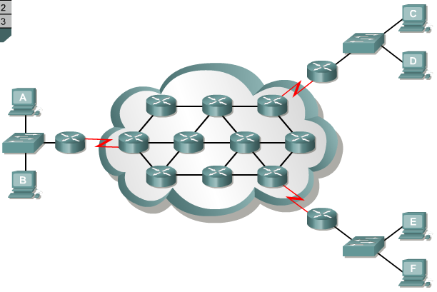
Basic WAN Setup
LAN 3
Internet
LAN 1
LAN 2

Slide 10
Campus Network (CAN)
Multiple buildings in close proximity
Administrators can connect buildings without using 3rd party service provider
Network looks like a large LAN
Buildings connected by high speed links
Typically Ethernet (100/1000 Mbps)
Bandwidth cost is basically capital cost of installing the links (like a LAN)
Examples
Microsoft – Redmond, WA
Cisco Systems – San Jose, CA
Any Boeing Plant – Renton, Kent, Auburn, Everett
Typical High School or College campus

Slide 11
Metropolitan Area Network (MAN)
Multiple buildings in close proximity
Administrators must use 3rd party service provider to connect buildings
Looks more like LANs connected by WANs
Because of single provider, may be able to negotiate lower rates for higher bandwidth
Bandwidth cost is monthly expense like WAN
Examples
Boeing Puget Sound Facilities (10+ campuses)
Typical School District with multiple campuses

Slide 12
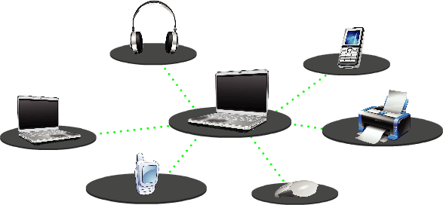
Personal Area Networks (PANs)
A personal area network (PAN) is a computer network used for communication between a computer and different information technological devices close to one person
Is a small network established for communication between different devices, such as laptops, computers, mobiles, and PDAs
A pan may include wired and wireless devices
The reach of a pan typically extends to 10 meters

Slide 13
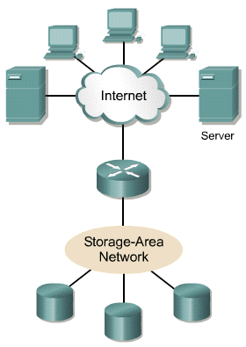
Storage-Area Networks (SANs)
High-speed server-to-storage, storage-to-storage, or server-to-server connectivity
Uses a separate network infrastructure that relieves any problems associated with existing network connectivity
Avoids any traffic conflict between clients and servers.
SANs offer the following features:
Performance – SANs enable concurrent access of disk or tape arrays by two or more servers at high speeds, providing enhanced system performance.
Availability – SANs have disaster tolerance built in, because data can be mirrored using a SAN up to 10 kilometers (km) or 6.2 miles away
Scalability – Allows easy relocation of backup data, operations, file migration, and data replication between systems

Slide 14
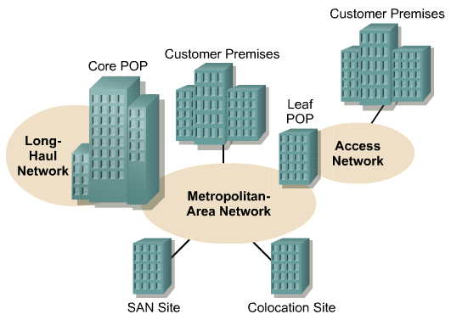
LAN, MAN, WAN, SANs Together
POP: Point of Presence
WAN Links
LAN Links

Slide 15
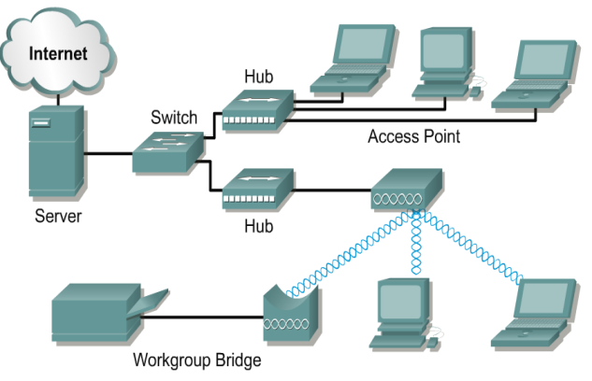
WLAN Extending the Network
Provides user mobility
Can be cheaper both short and long term
Provides access where copper won’t work

Slide 16
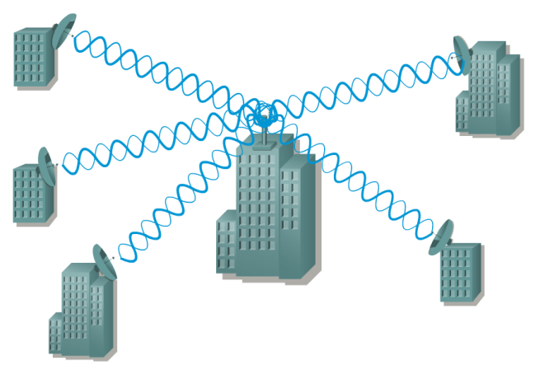
WLAN Linking Sites Together
May replace high cost WAN links
Requires unobstructed line-of-sight

Slide 17
Ad-hoc Wireless
A decentralized type of wireless network
The network is ad hoc because it does not rely on a pre-existing infrastructure such as routers in wired networks or access points in managed (infrastructure) wireless networks.
Instead, each node participates in routing by forwarding data for other nodes

Slide 18
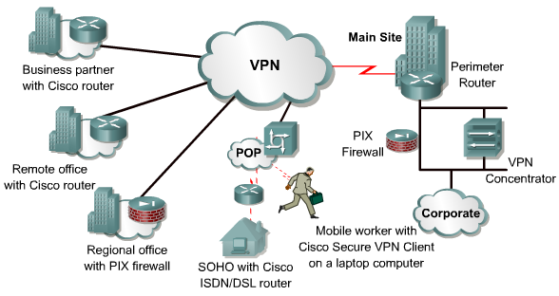
Virtual Private Networks (VPNs)
Creates secure connections through an unsecure network (Internet)
Can extend corporate network to branches, telecommuters
Lower cost alternative to leased lines (T1/E1) and Frame relay

Slide 19
Intranets
This is an internal corporate network that can be accessed by anyone on the internal network and can be password protected so that staff/employees can access it externally.

